Slide 1
Nicola Dahrendorf introduction
Refugee Lawyer
Humanitarian Worker
Academia
Human Rights Investigations
Sexual Violence
Mediation

Slide 2
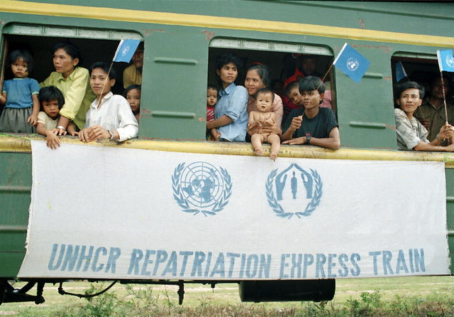
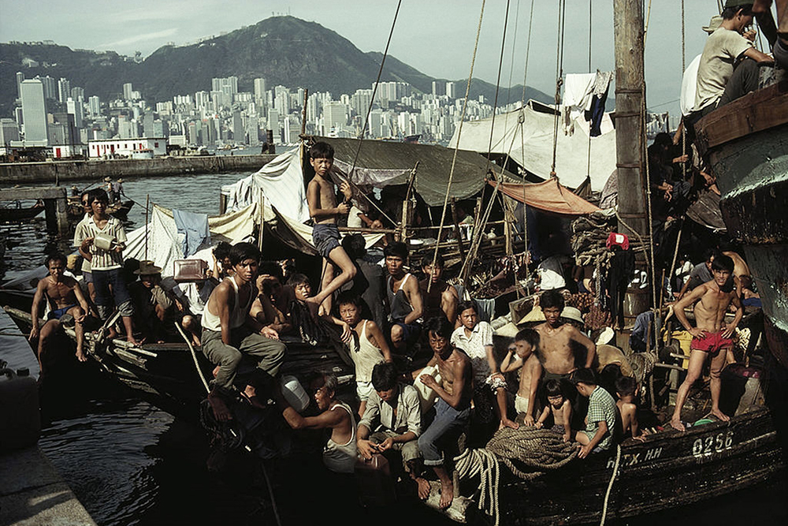
Refugees
Cambodian repatriation from Thailand
Hong Kong Vietnamese Boat people

Slide 3

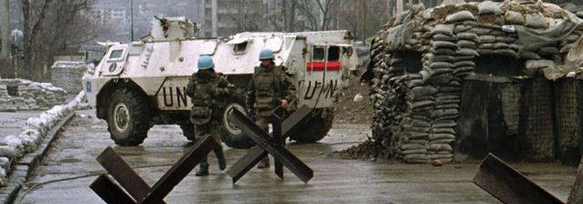
Refugees and Peace keeping
Sarajevo 1995

Slide 4
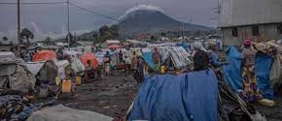
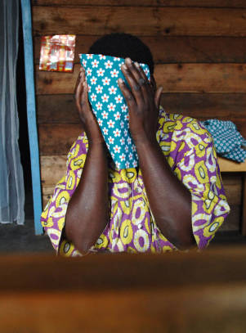
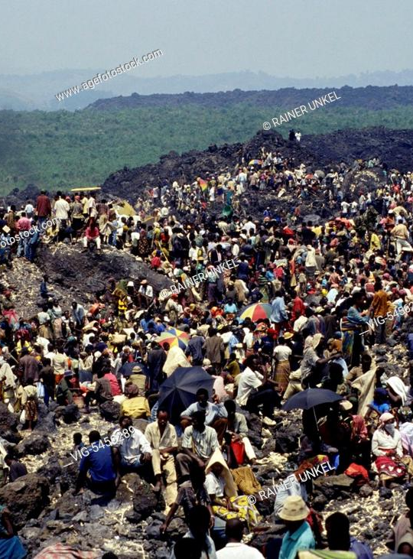
Zaire / democratic republic of congo (DRC)
1994
exodus after the Rwandan genocide
1997
Zaire becomes DRC
2005
Investigations into Un peacekeeping scandal on SEA and awareness of sexual violence

Slide 5
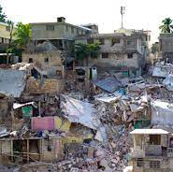
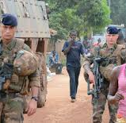
Humanitarian Disasters & human rights Investigations into sea
2010 Haiti after the earthquake and cholera outbreak
2015 scandal in Central African republic of allegations of misconduct by French & Un peacekeepers

Slide 6
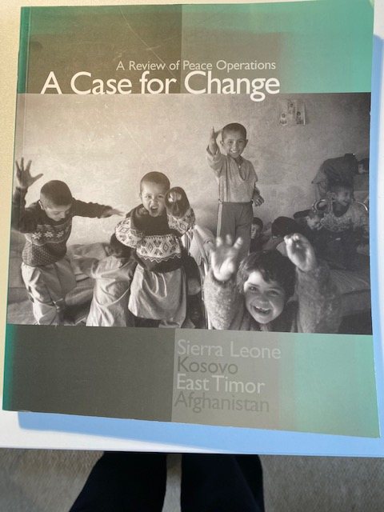
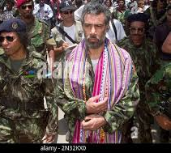
Post conflict security &justice academia: a Review of un peace operations
East timor post conflict, lead up to independence, national security adviser
Academia: review of four peace operations: Afghanistan, east timor, Kosovo & sierra leone

Slide 7
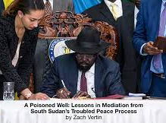
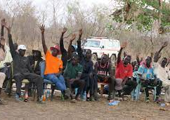

Peace processes and mediation
Numerous post conflict negotiations and consequences
Mediation training: making voices hear through arts practice?

