Slide 1


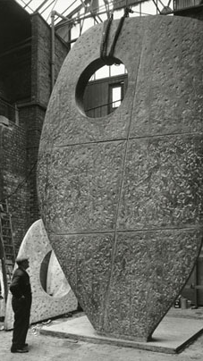

Is there a role for arts practice in peace mediation processes? Nicola Dahrendorf 23 February 2022
Institute of Advanced Studies for the Humanities, University of Edinburgh

Slide 2
OUTLINE
1. FRAMING: Why this exploration?
2. What is the issue and what are the questions?
4. Concrete entry points: how can arts practice contribute in peace processes?
3.Key themes

Slide 3
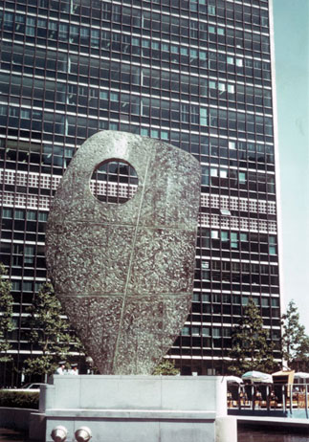
Single Form (Memorial) by Barbara Hepworth
z
A mediator: “Mediation is all about trying to shift people, who are stuck in the midst of conflict, to rethink the parameters of what is possible and to try and help people to think differently”.
An artist: “Art can defy linguistic boundaries and be an ideal resource to understand the perspectives of others. Art can also directly nurture a process by providing a voice to those who are marginalised – and at the same time enhance the relevance and legitimacy of the process itself ...”.

Slide 4
Terminology
Artists
Mediation 101: Track1, Track 2, Track 1.5 and Track 3
arts and arts practice

Slide 5
Mediation 101
Track 1: instrument of foreign policy for the establishment and development of contacts between the governments of different states through the use of intermediaries mutually recognised by the respective parties.
Track 2: Unofficial, informal interaction between members of adversary groups or nations that aim to develop strategies, to influence public opinion, organize human and material resources in ways that might help resolve their conflicts.
Track 1.5: Diplomatic initiatives that are facilitated by unofficial bodies, but directly involve officials from the conflict in question.
Track 3: Mostly informal interactions involving local leaders, e.g. community developers, grassroots NGOs, local peace committees, community mediation programmes, insider-mediators.

Slide 6
INTERLOCKING THEMES
z
TRUST - How can the Arts Contribute?
LANGUAGE - Listening, Spoken and Written Language, How can the Arts Contribute? and Stories and Narratives.
Convergence between Psychology and Mediation - The Role of the Mediator and Reflective Practices.
FURTHER EXPLORATION– Where Do the Qualities of Artists, Psychologists and Mediators Interconnect and How Can They Collaborate?

Slide 7
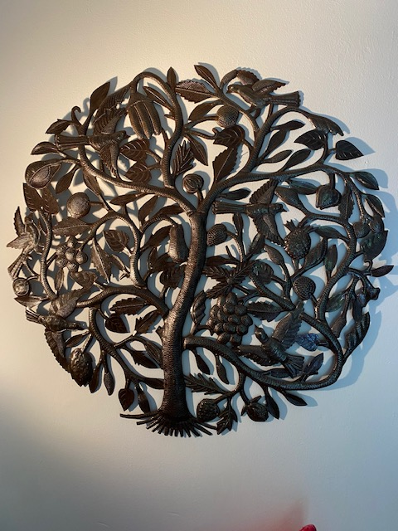
How can arts initiatives contribute in peace mediation?
z

Slide 8
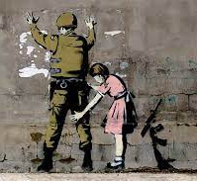
‘Art should comfort the disturbed and disturb the comfortable’ Banksy
z
SOME QUESTIONS TO EXPLORE:
Have we exhausted existing tools and means for peacebuilding?
Can arts practitioners assist with the issue of translation and interpretation – and if so, how?
Do we need a new generation of mediators with different ways of working?
How can mediation processes better harness the creative energy and understanding of younger people? How can arts practitioners help?
What does it feel like to be mediated on? How can artists assist in exploring this underexplored aspect?

